Slide 1
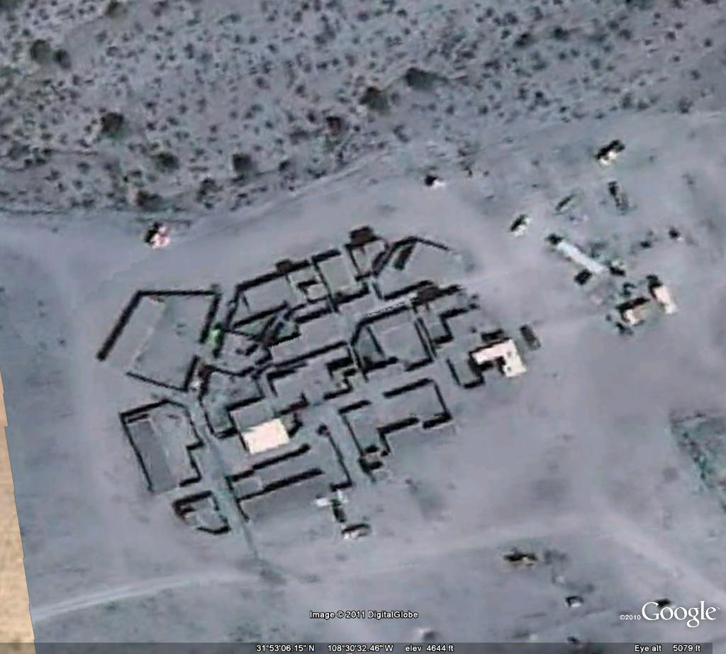
AFGHAN Village
Mosque
N

